Slide 1
TUPLES & SETS
BY
APSSDC

Slide 2

SESSION TOPICS
What is a Tuple ?
How to create a Tuple ?
Tuple Methods
Set Definition
Set Operations
Set Methods
Tasks & Examples
Notes:
How presentation will benefit audience: Adult learners are more interested in a subject if they know how or why it is important to them.
Presenter’s level of expertise in the subject: Briefly state your credentials in this area, or explain why participants should listen to you.

Slide 3
WHAT IS A TUPLE ?
A tuple in python is similar to a list. Means we can store different types of data at a time.
Tuples are immutable data structures.
Syntax: t = (1,2,3,4)
Notes:
Lesson descriptions should be brief.

Slide 4
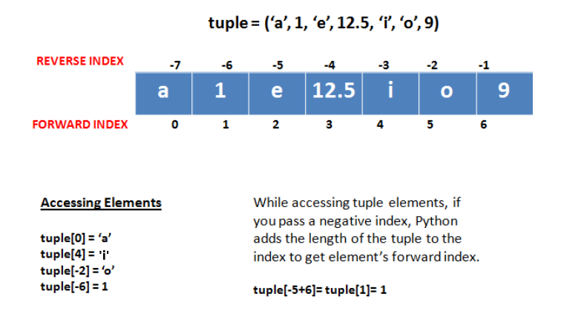
TUPLE CREATION & INDEXING
We can create a tuple by using parenthesis or with tuple() method.
Like String and Lists in tuples also indexing starts from 0.
Notes:
Example objectives
At the end of this lesson, you will be able to:
Save files to the team Web server.
Move files to different locations on the team Web server.
Share files on the team Web server.

Slide 5
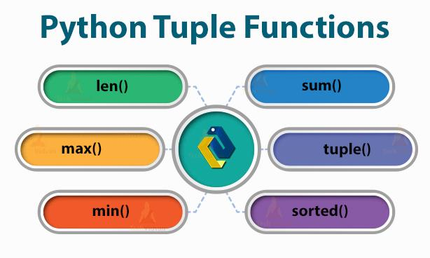
TUPLE METHODS

Slide 6
SET DEFINITION
A set is an unordered collection of items. Every set element is unique and must be immutable.
There is no Concept of Slicing and Indexing in Sets.
We can create a set by using curly brackets {} or with set() method.
Syntax: s = {1,2,3,4}

Slide 7
SET OPERATIONS
Sets can be used to carry out mathematical set operations like union, intersection, difference and symmetric difference.
We can do this with operators or methods.
We can perform membership operation also.

Slide 8
SET METHODS
We have many set methods in python.
By using dir() method we can get all methods in sets.
Syntax: dir(set)

Slide 9
TASKS
Write a Python program to find the repeated items of a tuple.
Write a Python program to remove an item from a tuple.
Write a Python program to reverse a tuple.
Write a Python program to find maximum and the minimum value in a set.
Write a Python Program to print multiplication sum of all the elements in a set.

Slide 10


